Slide 1
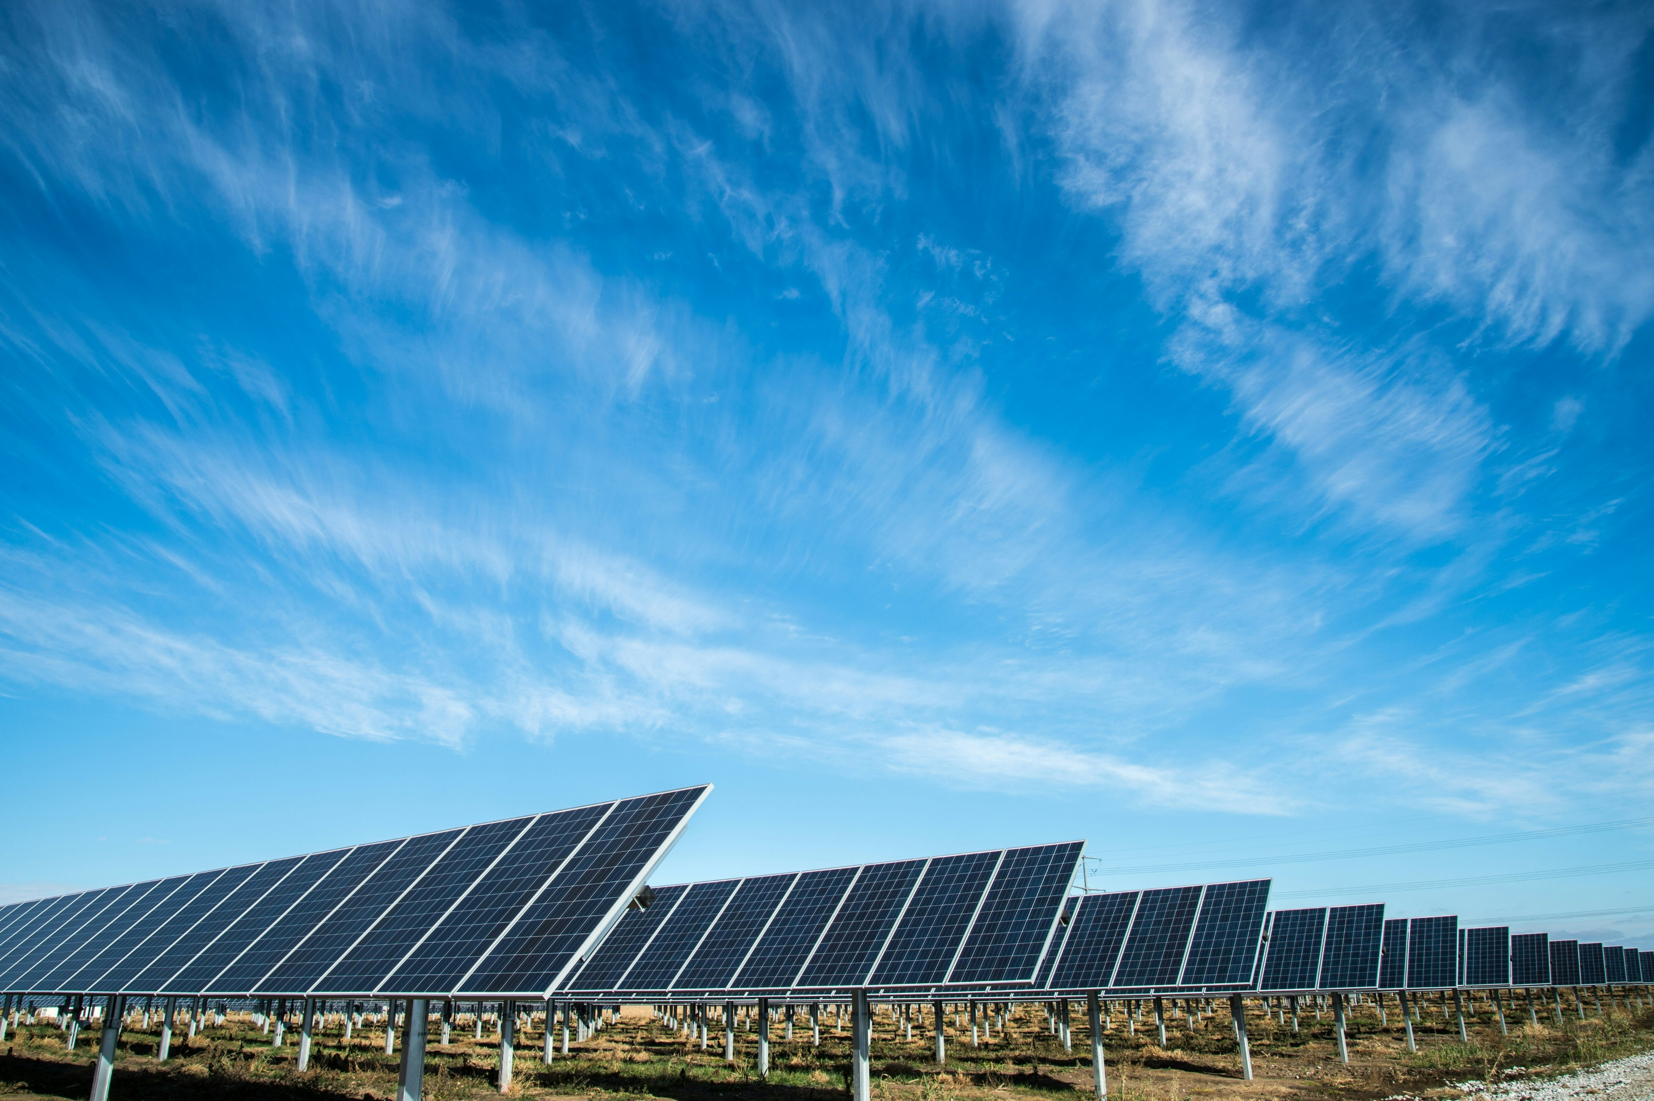
Clustering Solar Energy Production Zones

Slide 2

Agenda
Project Overview
Exploratory data analysis (EDA)
Data Preprocessing
Feature Engineering
Clustering Model (KMeans)

Slide 3
Project Overview
Project Overview

Slide 4
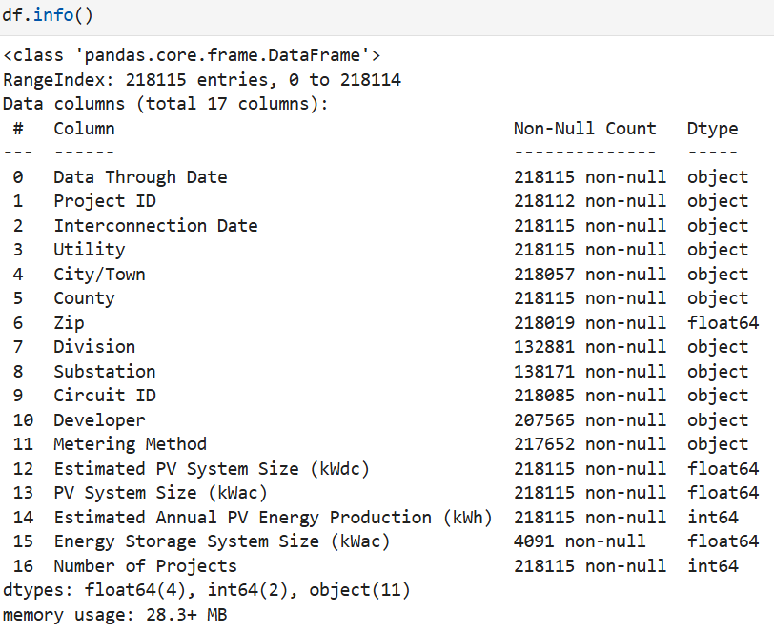
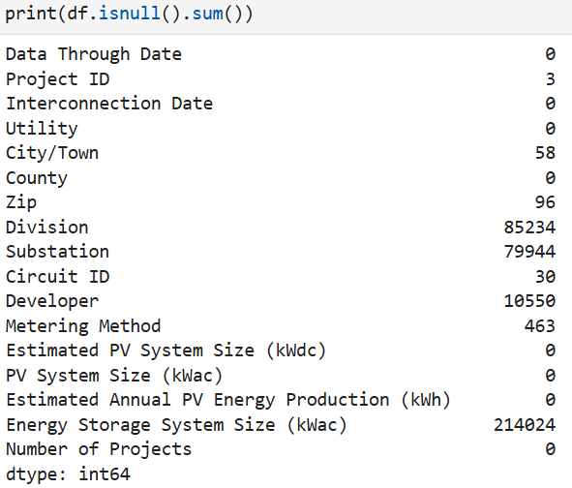
Exploratory data analysis (EDA)
In this process we check the null values of our data.
In this process we check the info of our data.

Slide 5
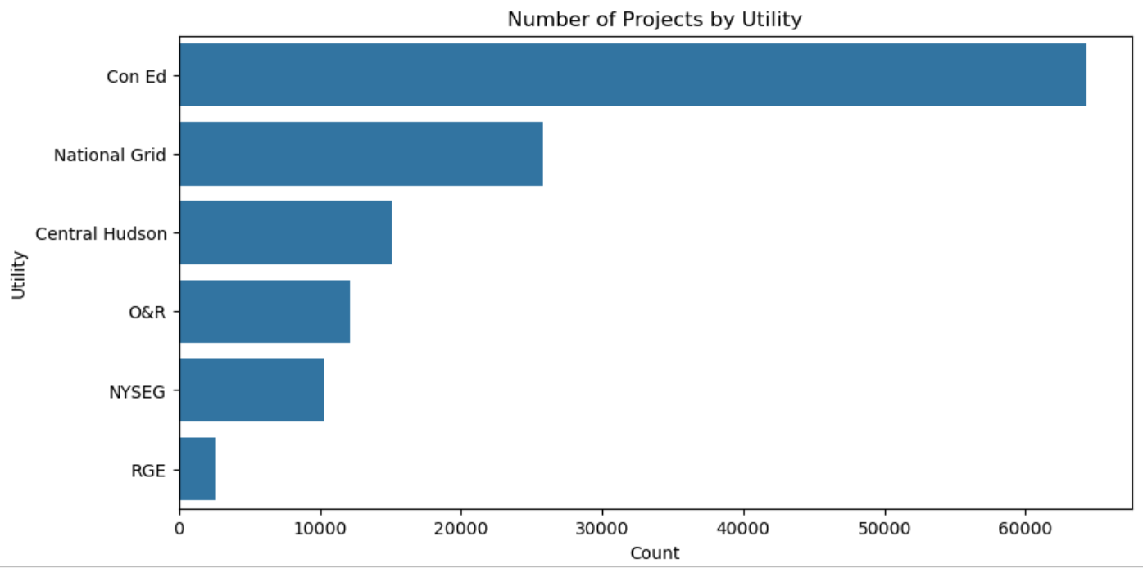
Exploratory data analysis (EDA)

Slide 6
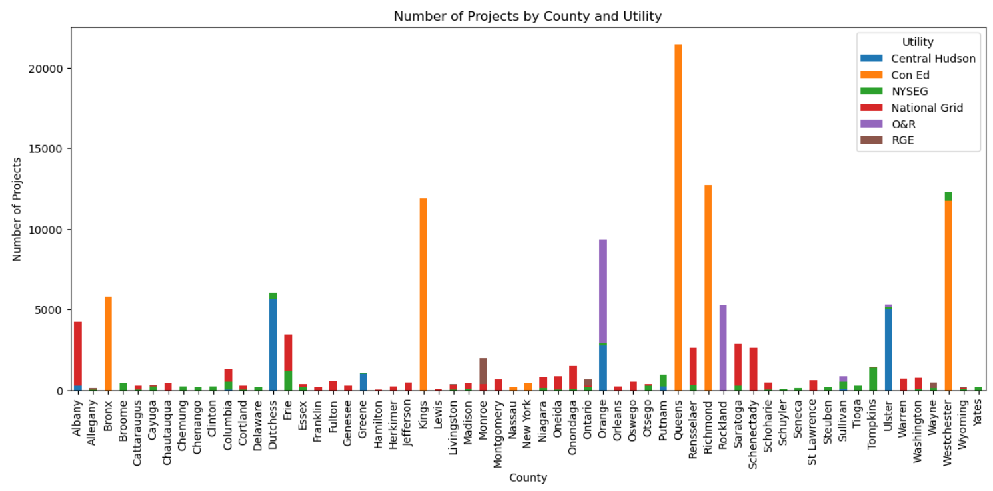
Exploratory data analysis (EDA)

Slide 7
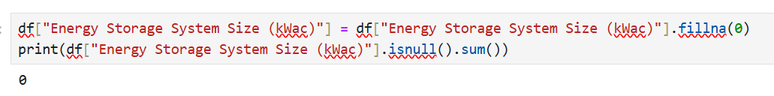
Data Preprocessing
The dataset has a substantial amount of null values however, the key features required for clustering remain unaffected by these null values.
To ensure the dataset's usability, we opted to drop all rows with null values except for one critical feature ‘Energy Storage System Size (kWac)’ which will be used in clustering.
For this feature, null values were replaced with 0, as it plays a significant role in the clustering process

Slide 8
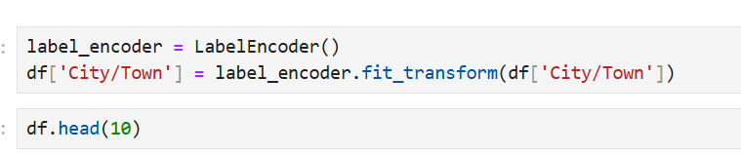
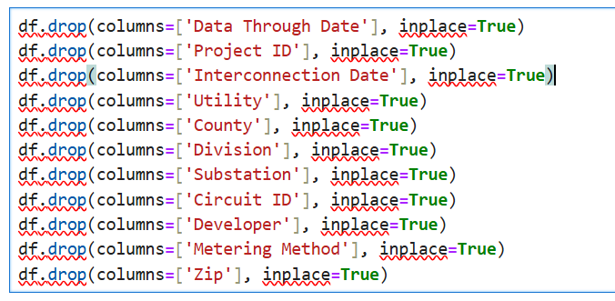

Feature Engineering
In this next process we convert categorical data into numerical data using Label Encoding.
In this case the columns is ‘City/Town’.
In this process we have dropped some features.

Slide 9
Feature Engineering
For clustering, we selected key features:
“City/Town”
"Estimated PV System Size (kWdc)“
"PV System Size (kWac)“
"Estimated Annual PV Energy Production (kWh)“
"Energy Storage System Size (kWac)“
Before finalizing these features, we performed outlier detection and identified a significant number of outliers. These were effectively handled and removed using the Interquartile Range (IQR) method to ensure data quality and reliability.

Slide 10
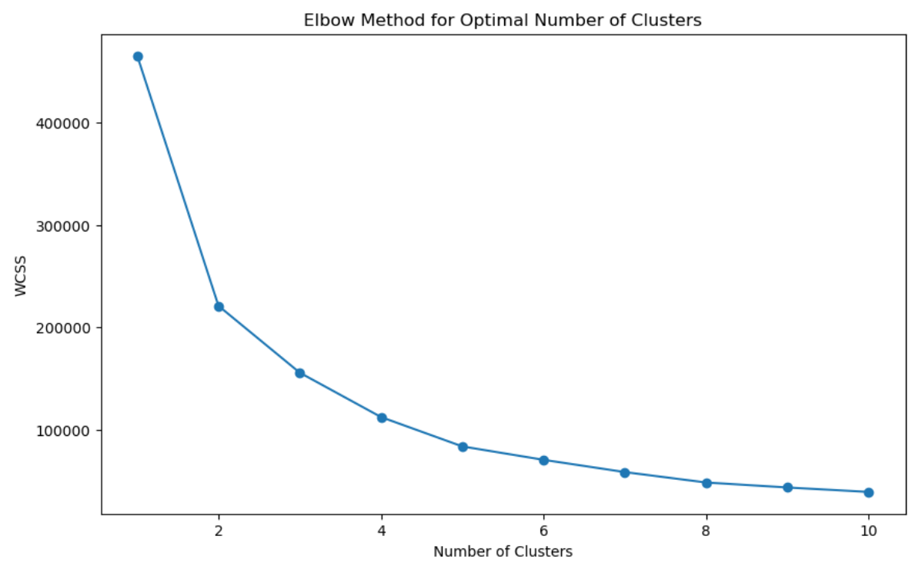
Clustering Model (KMeans)
In this next step, we applied the Elbow Method to determine the optimal number of clusters for our dataset.
The Elbow Method involves calculating the Within-Cluster Sum of Squares (WCSS) for different numbers of clusters.

Slide 11
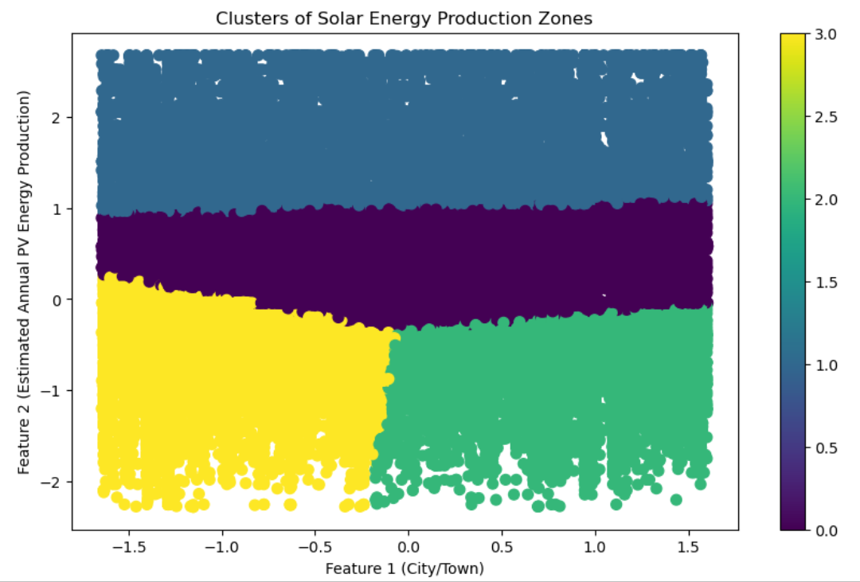
Clustering Model (KMeans)
The visualization shows distinct clusters represented by different colors.
x-axis corresponds to 'City/Town,' indicating geographical information.
y-axis represents 'Estimated Annual PV Energy Production,' which reflects the energy output for each location

Slide 12
THANK YOU

